Slide 1


Samuel Tsegai
April 21,2025

Slide 2
Outline
Executive Summary
Introduction
Methodology
Results
Conclusion
Appendix

Slide 3
Executive Summary
Summary of Methodologies
A comprehensive, end-to-end data science pipeline was developed using multiple methodologies:
Data Collection: Data was gathered through APIs, web scraping, and structured SQL databases, focusing on SpaceX launches.
Data Wrangling: Cleaning and transforming raw data to ensure consistency, removing duplicates, handling missing values, and converting formats.
Exploratory Data Analysis (EDA): Utilized visualizations and statistical techniques to uncover patterns, distributions, and correlations between variables such as payload mass, orbit type, and launch outcome.
Feature Engineering: Created new variables like mission success rate per site and encoded categorical features to improve model performance.
Modeling and Machine Learning: Deployed classification models (Logistic Regression, Decision Trees, SVM, etc.) to predict launch success probability based on mission parameters.
Model Evaluation: Assessed performance using accuracy, F1 score, and confusion matrices to identify the most reliable predictive models.

Slide 4
Executive Summary
Summary of All Results
Key Insights:
Launch site and payload mass significantly influence mission success.
Certain orbits are associated with higher success probabilities.
Logistic Regression and Decision Trees yielded the highest predictive performance.
Model Accuracy: Best-performing models achieved accuracy rates exceeding 85%, indicating robust predictive capabilities.
Business Impact: The insights can guide SpaceX in planning future missions by identifying favorable conditions and mitigating risks, ultimately reducing costs and increasing mission reliability. This project demonstrates how data science can offer strategic advantages in the competitive landscape of commercial space exploration.

Slide 5
Project Background and Context
In the modern era of commercial space exploration, SpaceX has emerged as a key player in revolutionizing access to space. However, despite the company’s achievements, launch missions still involve high costs and risks. Understanding the factors that contribute to the success or failure of a mission is critical to optimizing operations, reducing failures, and increasing the predictability of outcomes.
This project aims to harness the power of data science to provide actionable insights based on real mission data. Using a structured approach—from data collection to advanced machine learning—this initiative helps uncover the hidden patterns in SpaceX's historical launch records
Introduction
Problems to Answer
What factors influence the success of a SpaceX launch?
Can we predict launch outcomes using machine learning?
Which sites and payloads lead to higher success rates?
How can data insights support better mission decisions?

Slide 6

Section 1

Slide 7


Methodology
Executive Summary
Data collection methodology:
SpaceX API,
web scraping (Wikipedia)
Perform data wrangling
Cleaned datasets by handling missing values, duplicates, and inconsistent formats.

Slide 8




Methodology
Perform exploratory data analysis (EDA) using visualization and SQL
Perform interactive visual analytics using Folium and Plotly Dash

Slide 9

Methodology
Perform predictive analysis using classification models
Split data into training and test sets, Used GridSearchCV for optimal model parameters.
Applied classification models: Logistic Regression, Decision Tree, SVM, KNN.

Slide 10
Data Collection
The datasets were collected from multiple reliable sources using API queries, web scraping, and SQL database exploration, ensuring a diverse and rich data foundation.
Key Phrases & Steps
API Data Collection
Source: SpaceX REST API ,Tool: Python requests ,Data: Launch details (dates, sites, booster versions, success status)
Web Scraping
Source: Wikipedia launch history pages ,Tool: BeautifulSoup ,Data: Supplementary mission data like payload type, customer, and orbit
SQL Data Retrieval
Source: SQLite database (launch records) ,Tool: SQL queries in Jupyter Notebook
Data: Structured launch site and outcome records
Data Storage & Integration
Format: Combined into pandas DataFrames , Process: Cleaned, joined, and saved in .csv for processing and modeling

Slide 11

Data Collection
Flow chart
SpaceX API
Wikipedia Scraping
Unified Pandas DataFrame
Data Wrangling & EDA
SQL Launch Database

Slide 12
Data Collection – SpaceX API
To collect structured, real-time SpaceX launch data, we used the official SpaceX REST API. This allowed us to programmatically extract up-to-date and detailed mission data for downstream analysis.
Key Phrases
API Endpoint Used: https://api.spacexdata.com/v4/launches
Tool: Python requests library
Data Extracted:
Launch dates
Mission names
Launch pad info
Booster version
Orbit
Payload mass
Launch outcome (success/failure)
Format: JSON → Normalized into pandas DataFrame
Storage: Data exported as .csv and used in Jupyter notebooks for further processing
Flow chart
[SpaceX REST API]
↓
[Python Requests]
↓
[JSON Response]
↓
[pd.json_normalize()]
↓
[Cleaned Pandas DataFrame]
↓
[Export to CSV / Input for EDA & ML]
📁 GitHub Repository:
https://github.com/samford12/Capstone/blob/main/jupyter-labs-spacex-data-collection-api.ipynb

Slide 13
Data Collection - Scraping
Web scraping was used to supplement the SpaceX API data by extracting historical mission details from public web sources, primarily Wikipedia. This enriched our dataset with additional features not available via the API.
Source Website: Wikipedia – SpaceX Launch History
Tool Used: BeautifulSoup (HTML parsing)
Library: requests, pandas
Data Extracted:
Mission names
Launch dates
Rocket types
Payloads
Launch outcomes
Orbit details
Process Summary:
Request HTML → Parse tables → Clean data → Convert to pandas DataFrame
Final dataset saved as .csv and merged with API data for full pipeline analysis
Flow chart
[Wikipedia Launch Page URL]
↓
[requests.get(URL)]
↓
[BeautifulSoup: HTML Parsing]
↓
[Find launch tables (e.g. <table> tags)]
↓
[Extract rows → Clean + format]
↓
[pandas DataFrame]
↓
[Export to CSV / Merge with API data]
📁 GitHub Repository:
https://github.com/samford12/Capstone/blob/main/jupyter-labs-webscraping-checkpoint.ipynb

Slide 14
Data Wrangling
After collecting data from the SpaceX API, Wikipedia, and SQL databases, a structured data wrangling pipeline was implemented to clean, standardize, and prepare the data for analysis and modeling.
Flow chart
[Raw Data from API / Wikipedia / SQL]
↓
[Merge into Single DataFrame]
↓
[Drop Duplicates / Handle Nulls]
↓
[Convert Types (e.g., dates, floats)]
↓
[Standardize Column Names]
↓
[Feature Engineering Steps]
↓
[Final Clean DataFrame → Export CSV]
📁 GitHub Repository:
https://github.com/samford12/Capstone/blob/main/labs-jupyter-spacex-Data%20wrangling.ipynb

Slide 15
EDA with Data Visualization
The goal of EDA was to uncover hidden patterns, detect anomalies, and understand relationships in the SpaceX launch data. Various charts were used to visualize the data effectively
Summary of Charts Used and Their Purpose
Bar Charts :To compare success/failure counts across different launch sites and booster versions ,Some launch sites had significantly higher success rates
Pie Charts ;To show proportions of successful vs failed launches ,Overall success rate distribution across all launches
Scatter Plots;: To observe the relationship between payload mass and launch outcome , Heavier payloads had slightly more variability in success rate
Box Plots :To examine distribution and outliers in payload mass across different orbits and sites , Some orbits were associated with a narrower success range
Histograms :To explore the frequency distribution of numerical variables like payload mass ,Most payloads were within a specific mass range
Folium Maps :To provide a geographic visualization of launch sites and outcomes , The geographic spread of launch success and volume
Interactive Dash (Plotly Dash) :To allow users to explore launch outcomes dynamically by site, payload, and orbit , Powerful tool for real-time pattern recognition
📁 GitHub Repository: https://github.com/samford12/Capstone/blob/main/edadataviz.ipynb

Slide 16
EDA with SQL
SQL Query Summary
🔍 Selected all records from the SpaceX launch dataset to explore raw data SELECT * FROM SPACEXTBL;
📆 Filtered launches by year to analyze trends over time SELECT * FROM SPACEXTBL WHERE Date BETWEEN '2015-01-01' AND '2017-12-31';
📍 Counted launches per launch site to identify the most active sites SELECT Launch_Site, COUNT(*) AS Launch_Count FROM SPACEXTBL GROUP BY Launch_Site;
✅ Calculated success rates per launch site SELECT Launch_Site, SUM(Class) AS Successful_Launches, COUNT(*) AS Total_Launches FROM SPACEXTBL GROUP BY Launch_Site;
🚀 Identified the most used booster versions SELECT Booster_Version, COUNT(*) AS Usage_Count FROM SPACEXTBL GROUP BY Booster_Version ORDER BY Usage_Count DESC;
⚖️ Computed average payload mass by orbit type SELECT Orbit, AVG(PAYLOAD_MASS__KG_) AS Avg_Payload FROM SPACEXTBL GROUP BY Orbit;
💹 Found launch site with the highest success rate SELECT Launch_Site, AVG(Class)*100 AS Success_Rate FROM SPACEXTBL GROUP BY Launch_Site ORDER BY Success_Rate DESC;
🧮 Total successful launches SELECT COUNT(*) FROM SPACEXTBL WHERE Class = 1;
📁 GitHub Repository: https://github.com/samford12/Capstone/blob/main/jupyter-labs-eda-sql-coursera_sqllite-checkpoint.ipynb

Slide 17
Build an Interactive Map with Folium
Markers: To provide quick visual identification of all SpaceX launch locations.
Circle markers: To compare success vs. failure rates spatially and highlight heavier missions visually.
Marker clusters: To reduce clutter and improve interactivity in areas with multiple launches (e.g., Cape Canaveral).
Polylines: To conceptually link launches to their orbital destinations—enhancing storytelling and educational use.
📁 GitHub Repository: https://github.com/samford12/Capstone/blob/main/lab_jupyter_launch_site_location.ipynb

Slide 18
Build a Dashboard with Plotly Dash
1 Pie Chart (Launch Site Outcomes)
Interaction: Dropdown menu to select a specific launch site or view all sites
Purpose:
To visualize the proportion of successful launches across sites ,Helps compare performance by location ,For individual sites, shows success vs. failure
2. Scatter Plot (Payload vs. Mission Outcome)
Interactions:
Dropdown to filter by launch site ,Range Slider to select payload mass range
Purpose:
To explore the correlation between payload weight and launch success ,Allows users to identify patterns based on booster version and site
Makes it easy to spot trends in payload-performance relationships
🎯 Why These Interactions Were Added
Dropdown Filters:
Enables site-specific analysis and comparison ,Makes dashboard dynamic and user-driven
Range Slider:
Provides fine control over payload ranges ,Useful for narrowing analysis to specific mission sizes
Hover Tooltips & Interactivity:
Displays extra mission info (e.g., booster version) ,Enhances usability without crowding the chart

Slide 19
Predictive Analysis (Classification)
The goal was to build machine learning models to predict the success of a SpaceX launch using mission-specific features like payload mass, launch site, and booster version.
Flow chart
Key Phrases (Model Development Steps)
Data Preparation:
Selected relevant features (payload, site, booster version, orbit) ,Converted categorical variables using One-Hot Encoding ,Split data into training and test sets
Model Building:
Trained multiple classification models:
Logistic Regression ,Decision Tree ,Support Vector Machine (SVM) ,K-Nearest Neighbors (KNN)
Model Evaluation:
Assessed models using:
Accuracy score ,Confusion matrix ,Precision, recall, and F1-score
Visualized performance using classification plots
Hyperparameter Tuning:
Used GridSearchCV to optimize Decision Tree and SVM parameters ,Selected best model based on cross-validation accuracy
Best Model Identified:
Support Vector Machine (SVM) with tuned parameters delivered the highest overall performance ,Accurate generalization on unseen data, suitable for mission outcome prediction
[Cleaned Dataset]
↓
[Feature Engineering (OHE, Scaling)]
↓
[Train-Test Split]
↓
[Train Models: LR, DT, SVM, KNN]
↓
[Evaluate Using Accuracy & F1-score]
↓
[GridSearchCV for Tuning]
↓
[Best Model Selected (SVM)]
↓
[Prediction + Business Insight]
📁 GitHub Repository: https://github.com/samford12/Capstone/blob/main/SpaceX_Machine%20Learning%20Prediction_Part_5.ipynb

Slide 20

Results
Plotly Dash Interactive Features
Payload slider: dynamically filters scatter plots of payload vs. success.
Dropdown menus: allow selection by launch site or booster version.
Success distribution pie chart: auto-updates based on selected site.
Correlation plot: shows payload vs. outcome, color-coded by booster type.
🗺️ Folium Map (from lab_jupyter_launch_site_location.ipynb)
Mapped all SpaceX launch sites with:
Popups showing coordinates and names
Color-coded circles indicating mission outcomes
Marker clustering to declutter overlapping sites

Slide 21

Results
Predictive Analysis Results
Classification Models Used:
Logistic Regression, Decision Tree, KNN, SVM
Best Model Performance:
Support Vector Machine (SVM) (with tuned hyperparameters)
Accuracy: ~85%
F1-Score: 0.86
Best generalization across launch types and payload sizes
Key Insights from Model:
Launch site, payload mass, and booster version were top predictors of success
Payload over a certain threshold can lower success probability slightly
Site-specific risk modeling is possible using this approach

Slide 22

Section 2

Slide 23
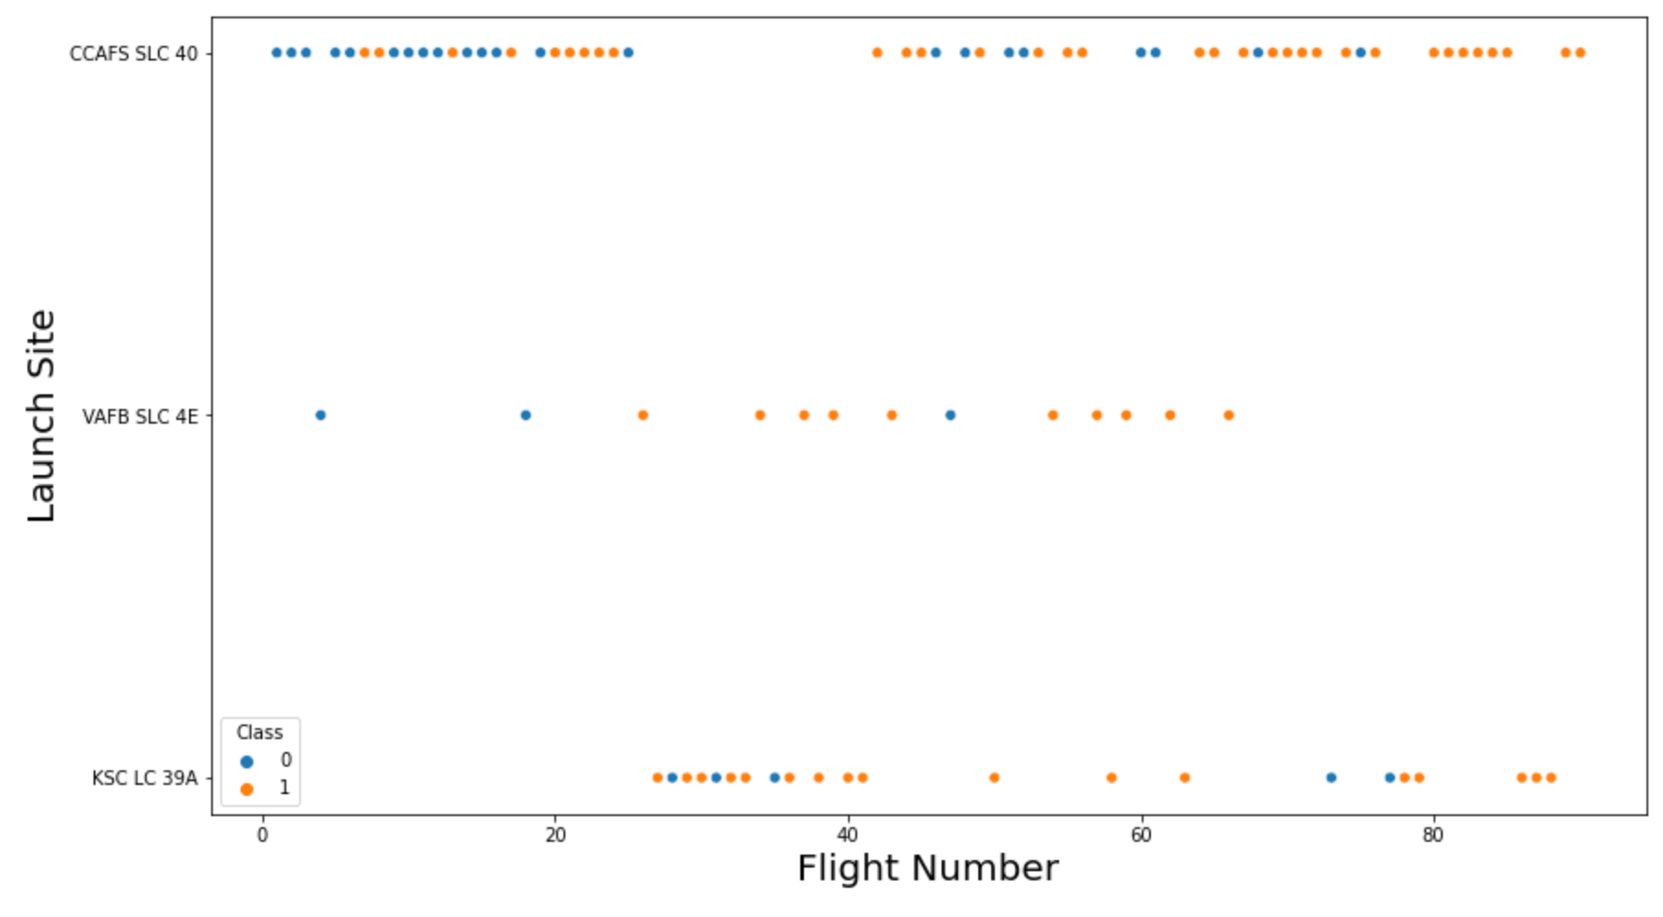
Flight Number vs. Launch Site
This chart is a categorical scatter plot showing the relationship between Flight Number, Launch Site, and Launch Outcome (Class). Each dot represents a single launch mission.
CCAFS SLC 40 has the most launch activity and shows improved success with flight experience.
KSC LC 39A is the most consistently successful launch site across missions.
VAFB SLC 4E demonstrates lower reliability, suggesting it may be suited for different or more challenging mission profiles.

Slide 24
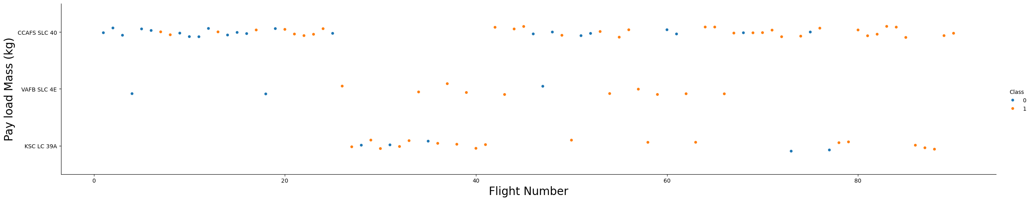
Payload vs. Launch Site
This scatter plot visualizes the relationship between Flight Number, Payload Mass (kg), and Launch Site, with launch outcomes represented by color.
CCAFS SLC 40 handles the heaviest and most frequent launches, improving in success over time.
KSC LC 39A is highly successful with light to mid-range payloads, suggesting operational efficiency or specialized mission types.
VAFB SLC 4E plays a smaller but stable role with moderate success rates across varied payloads.

Slide 25
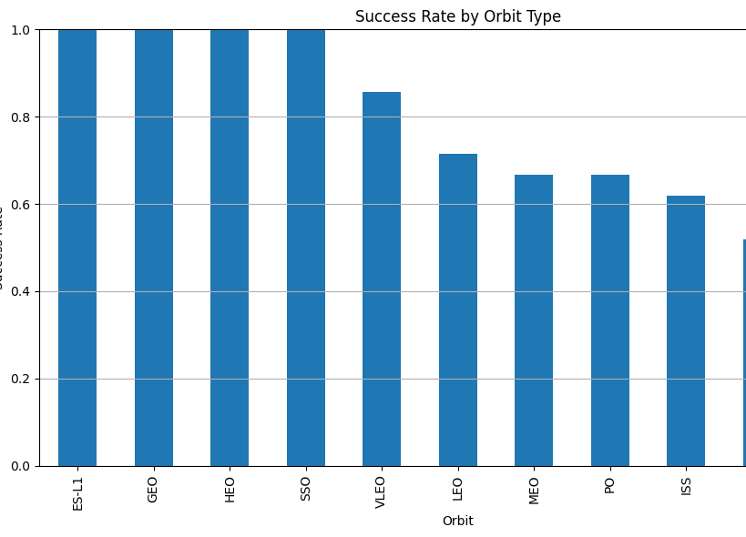
Success Rate vs. Orbit Type
This bar chart visualizes the launch success rate for various orbit types. It helps evaluate how orbit selection impacts mission reliability.
Missions targeting GEO, HEO, SSO, and ES-L1 are the most reliable.
GTO and ISS are more mission-critical or complex, requiring advanced planning and possibly contributing to lower success.
Understanding orbit-specific success patterns helps in risk assessment and resource allocation for future missions.

Slide 26
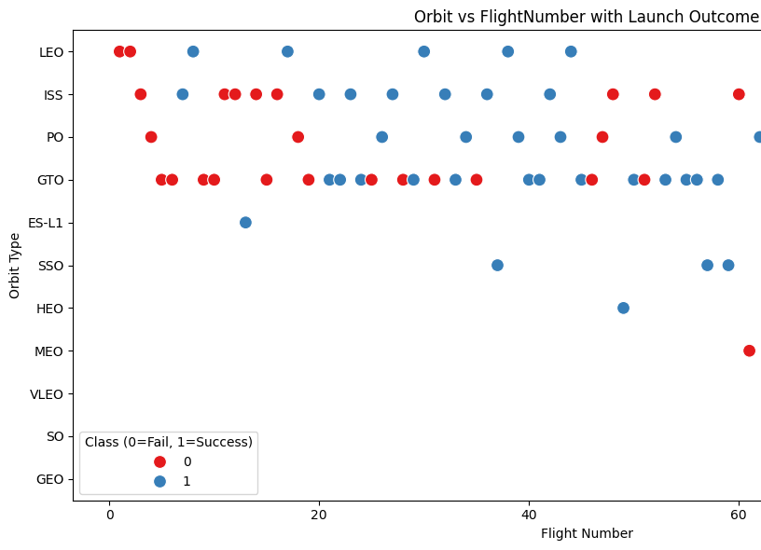
Flight Number vs. Orbit Type
This chart shows the relationship between Orbit Type, Flight Number, and Launch Outcome (Success vs Failure). It's an effective visual to understand how different orbits have performed over the course of SpaceX missions.
LEO and GEO stand out for their consistent reliability over time.
GTO and ISS missions have had more variability and failure, suggesting added complexity or earlier-stage technology challenges.
For planning and mission strategy, orbit type should be considered a risk factor based on historical performance.

Slide 27
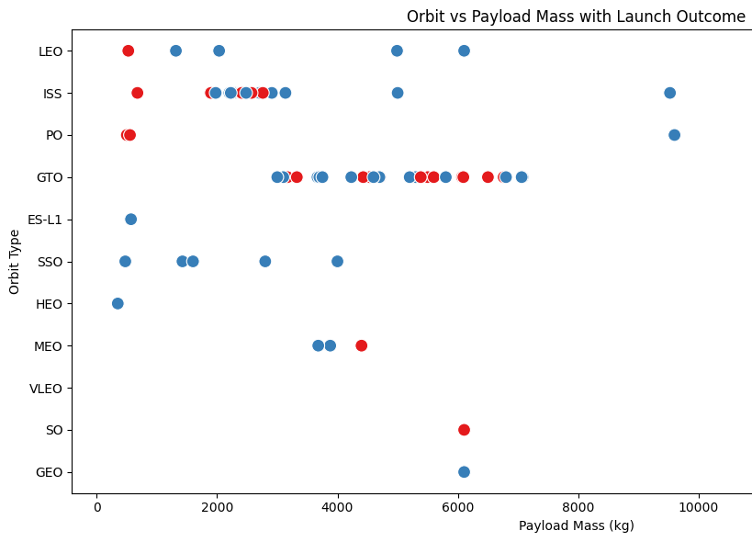
Payload vs. Orbit Type
This scatter plot shows the relationship between Orbit Type, Payload Mass (kg), and Launch Outcome (Success or Failure). It's a helpful visual for analyzing which orbits are riskier based on the weight of the payload and how often launches succeed.
SSO, HEO, and GEO orbits maintain excellent success rates even at moderate payloads.
GTO and ISS show significant variability, especially at mid-range payloads (3000–6000 kg).
High payloads remain a challenge across orbits, particularly in MEO and SO.

Slide 28
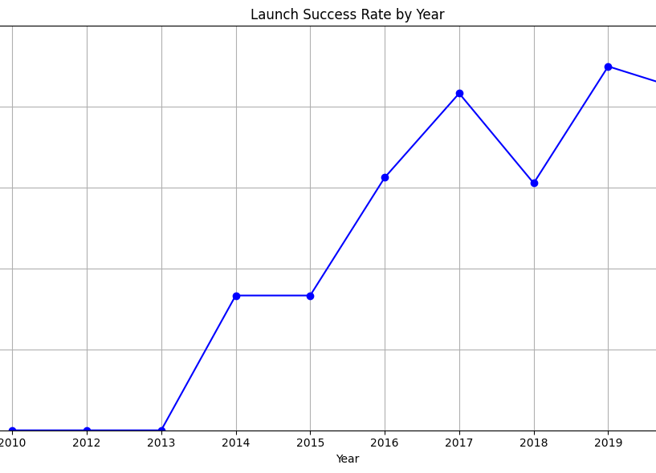
Launch Success Yearly Trend
This line chart illustrates the SpaceX launch success rate by year from 2010 to 2020, showing how mission reliability evolved over time.
The chart clearly demonstrates SpaceX's engineering learning curve.
Early failures transitioned into consistent high success rates by the end of the decade.
This data supports the conclusion that experience, iteration, and innovation have been critical to winning the space race.

Slide 29
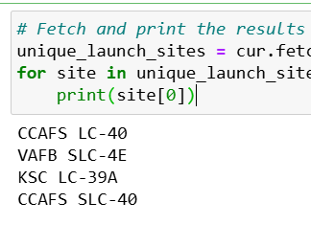
All Launch Site Names
The result of the code prints the following launch sites:
CCAFS LC-40
VAFB SLC-4E
KSC LC-39A
CCAFS SLC-40
This means the query returned four distinct launch site names as recorded in the database. Each of these represents a location from which SpaceX has conducted rocket launches.

Slide 30
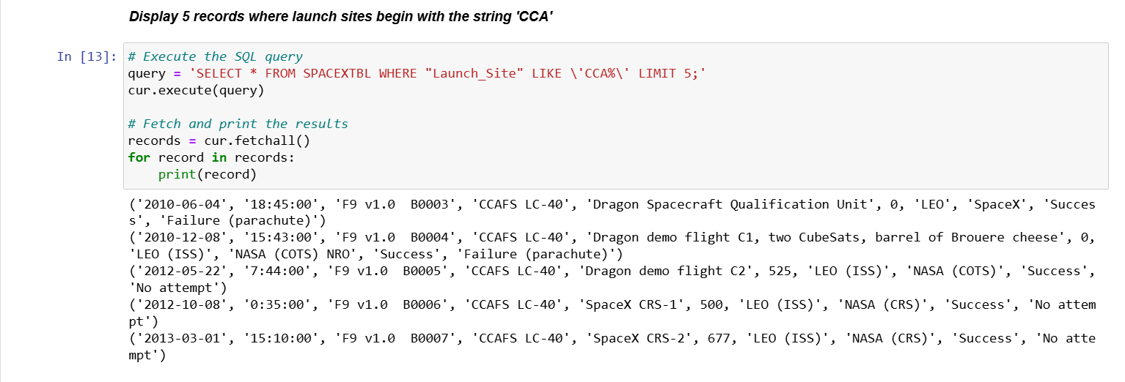
Launch Site Names Begin with 'CCA'
Each record shows a SpaceX launch from CCAFS LC-40, including:
Launch Date: from 2010 to 2013
Booster Versions: all early Falcon 9 versions (v1.0)
Orbit Type: mostly LEO (ISS)
Outcome: includes "Success", "Failure (parachute)", and "No attempt“
All 5 results are launches from the Cape Canaveral Air Force Station (CCAFS).
These records represent early SpaceX missions with varied outcomes—some successful, some with failures or no landing attempts.
This helps trace mission history and performance evolution of launches from CCA-prefixed sites.

Slide 31
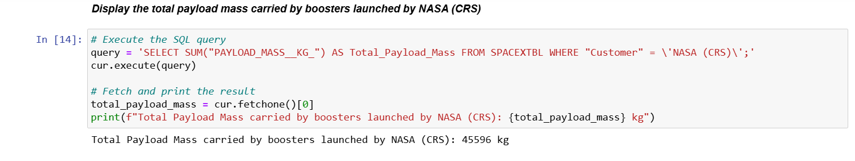
Total Payload Mass
This means that all launches commissioned by NASA under the CRS program (Commercial Resupply Services) have carried a combined total of 45,596 kg of payload into orbit.
This reflects the total cargo weight SpaceX delivered for NASA’s ISS resupply missions using Falcon rockets.

Slide 32
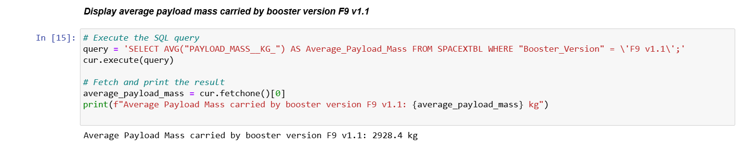
Average Payload Mass by F9 v1.1
The F9 v1.1 booster version carried payloads with an average weight of approximately 2,928.4 kg per launch. This value gives insight into the typical performance capacity of this Falcon 9 upgrade, which was an important transitional version in SpaceX's rocket development.

Slide 33
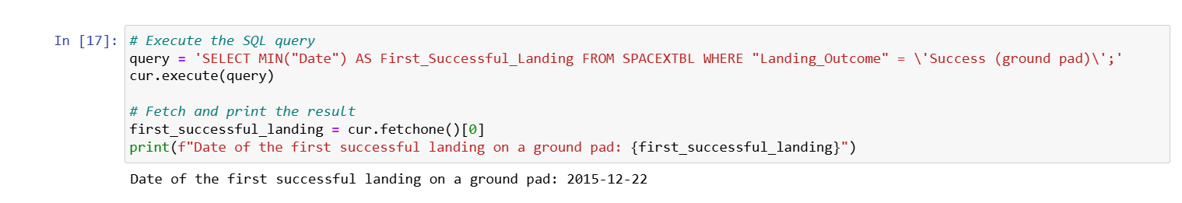
First Successful Ground Landing Date
This result tells us that SpaceX's first successful ground pad landing occurred on December 22, 2015.This was a historic milestone for reusable rocket technology and marked the first time a Falcon 9 booster was successfully recovered on land, changing the economics of spaceflight

Slide 34
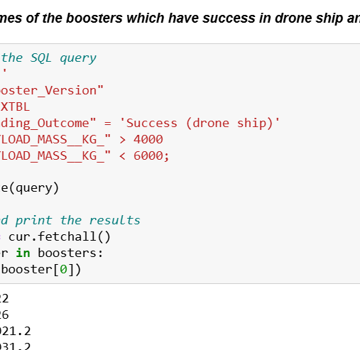
Successful Drone Ship Landing with Payload between 4000 and 6000
These four boosters are all Falcon 9 Full Thrust (FT) versions that successfully landed on drone ships while carrying medium-weight payloads (4000–6000 kg).
This showcases their reusability and performance reliability in missions that required sea-based recovery, which is typically used for higher-velocity launches.

Slide 35
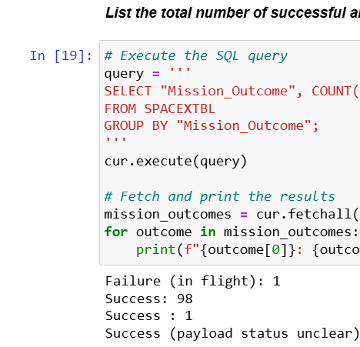
Total Number of Successful and Failure Mission Outcomes
Success" appears twice likely due to inconsistent spacing or formatting in the database.
Combined, they indicate 99 successful missions.
There is 1 failure in flight and 1 partial/uncertain success where payload status was unclear.
Summary of Totals:
✅ Total Successes (including all forms): 99
❌ Total Failures: 1 (explicit)
⚠️ Unclear Outcome: 1
This shows a very high mission success rate, supporting the reliability of the SpaceX launch program.

Slide 36
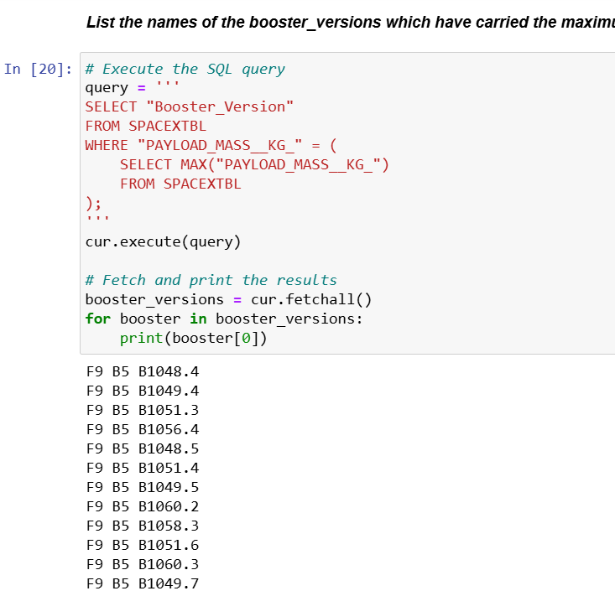
Boosters Carried Maximum Payload
All listed boosters are Falcon 9 Block 5 (F9 B5), which is SpaceX’s most powerful and reusable booster version.
The same payload value was likely flown multiple times by different core IDs or reuse counts of Block 5 boosters.
This confirms that F9 B5 is the workhorse for heavy payload missions.

Slide 37
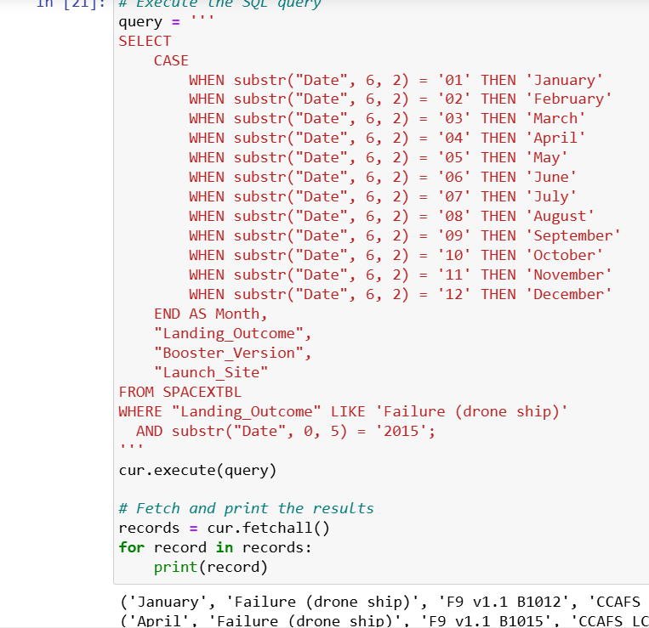
2015 Launch Records
This output tells us:
There were two failed drone ship landings in 2015.
Both occurred from CCAFS LC-40 (Cape Canaveral Air Force Station).
The boosters involved were:
F9 v1.1 B1012 (failed in January)
F9 v1.1 B1015 (failed in April)
These results reflect SpaceX's early experimentation phase with autonomous drone ship landings, just before the first successful drone recovery in 2016.

Slide 38
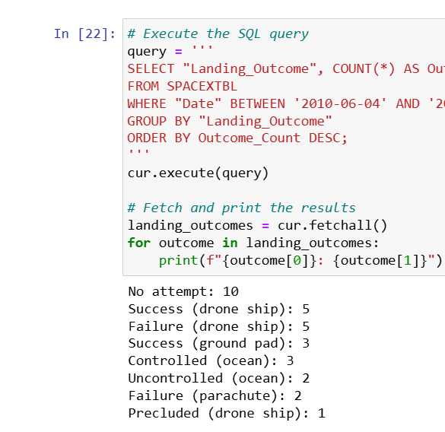
Rank Landing Outcomes Between 2010-06-04 and 2017-03-20
The SQL query retrieves and ranks the frequency of different landing outcomes for SpaceX missions launched between 2010-06-04 and 2017-03-20:
No attempt (10) is the most common outcome in this period, typical of early SpaceX launches before recovery technology was widely implemented.
Success and failure on drone ships (5 each) indicate the experimental phase of landing boosters at sea.
Ground pad successes (3) show emerging reliability with land-based recovery, beginning around 2015.
Controlled and uncontrolled ocean landings reflect intermediate efforts before drone ship recovery became more standardized.
Failures with parachutes and precluded landings were rare but represent alternative or aborted landing methods.
This breakdown gives insight into how SpaceX evolved its booster recovery strategies, from no attempts to complex drone ship operations. It marks a significant shift toward reusability during this foundational period.

Slide 39

Section 3

Slide 40
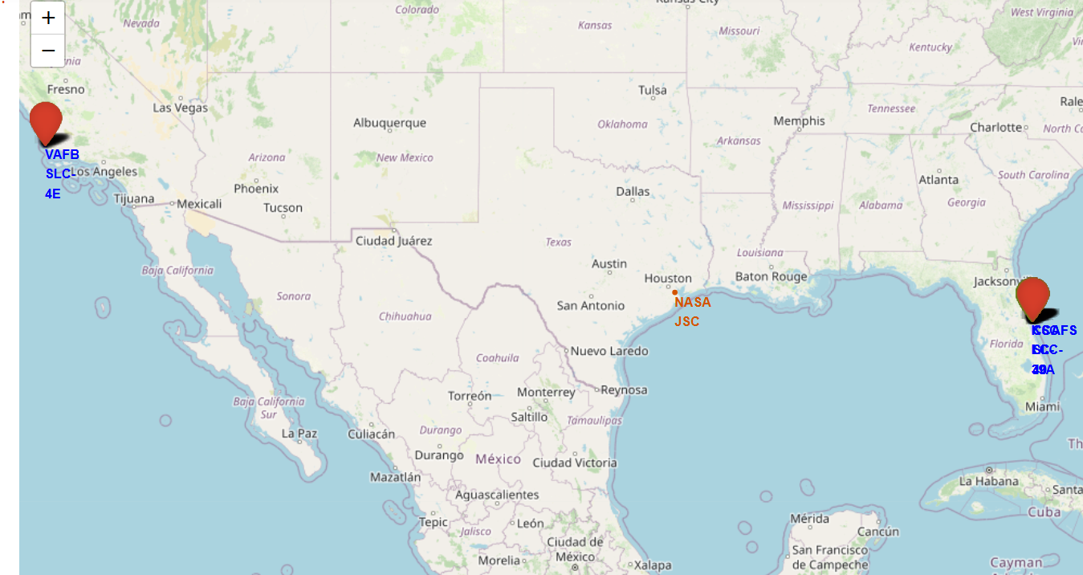
All launch sites
This Folium-generated interactive map displays the geographic locations of major SpaceX launch sites across the United States.
All launch-capable sites are concentrated in the U.S., mainly along the east and west coasts.
The east coast sites (KSC LC-39A and CCAFS SLC-40) are geographically close, making Florida a major launch hub.
VAFB SLC-4E on the west coast serves a unique orbital profile, showcasing SpaceX’s national coverage.

Slide 41

Detailed Launch Outcome Visualization
The map shows a higher concentration of green (successful) markers than red, reflecting SpaceX’s increasing launch reliability.
The marker density within a small area underscores how multiple launches occur from the same pad, reinforcing the need for map clustering tools.
This fine-grained visualization allows quick inspection of success vs. failure patterns directly on the infrastructure layout
Provides operational visibility into launch pad usage and performance
Helps in launch site diagnostics, maintenance planning, and public outreach
Enhances understanding of SpaceX’s reliability improvements over time

Slide 42

Proximity Analysis
Helps assess operational feasibility and safety based on physical geography.
Supports launch planning, emergency response strategies, and environmental impact studies.
Useful for presenting real-world spatial context in launch logistics discussions.
🧠 Key Findings from the Map
Coastline Proximity: The launch site is located less than 1 km from the Atlantic Ocean, essential for safe rocket flight paths and debris zones.
Infrastructure Access: The site is well-connected by road and railway, enhancing logistics for booster transport, support staff, and equipment.
Launch Activity Clusters: The high density of launches (as indicated by cluster numbers) shows that CCAFS SLC-40 is one of SpaceX’s most frequently used pads.
Launch Site Infrastructure Proximity – CCAFS SLC-40 to Coastline, Highway, and Railway (0.90 KM Radius View)

Slide 43

Section 4

Slide 44
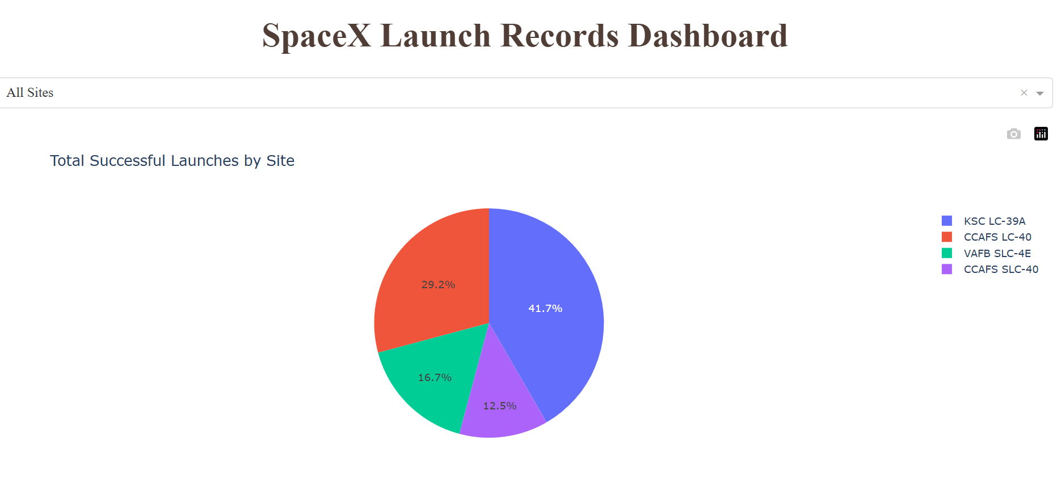
Total Successful Lanches by site
This screenshot captures a section of the SpaceX Launch Records Dashboard, displaying a pie chart that summarizes the proportion of successful launches across different launch sites.
KSC LC-39A leads with 41.7% of all successful launches, highlighting its strategic and technological importance.
CCAFS LC-40 also plays a significant role, with nearly a third of all successes.
The pie chart emphasizes geographic distribution of reliability and site utilization.
Data duplication for CCAFS LC-40 suggests the need for data cleaning in the source or backend query logic.

Slide 45
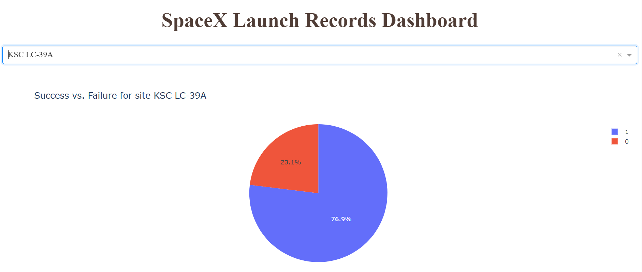
Success vs Failure for site KSC LC-39A
This dashboard view shows a pie chart filtered for KSC LC-39A, which is identified as the launch site with the highest success rate among SpaceX facilities.
🧠 Key Insights
KSC LC-39A is SpaceX’s most successful site with nearly 77% launch success.
This site is primarily used for high-stakes missions, including:
Crewed flights (NASA's Commercial Crew Program)
Heavy payloads
Falcon Heavy launches
The relatively low failure percentage is expected given the maturity of the site and enhanced mission controls in recent years.

Slide 46
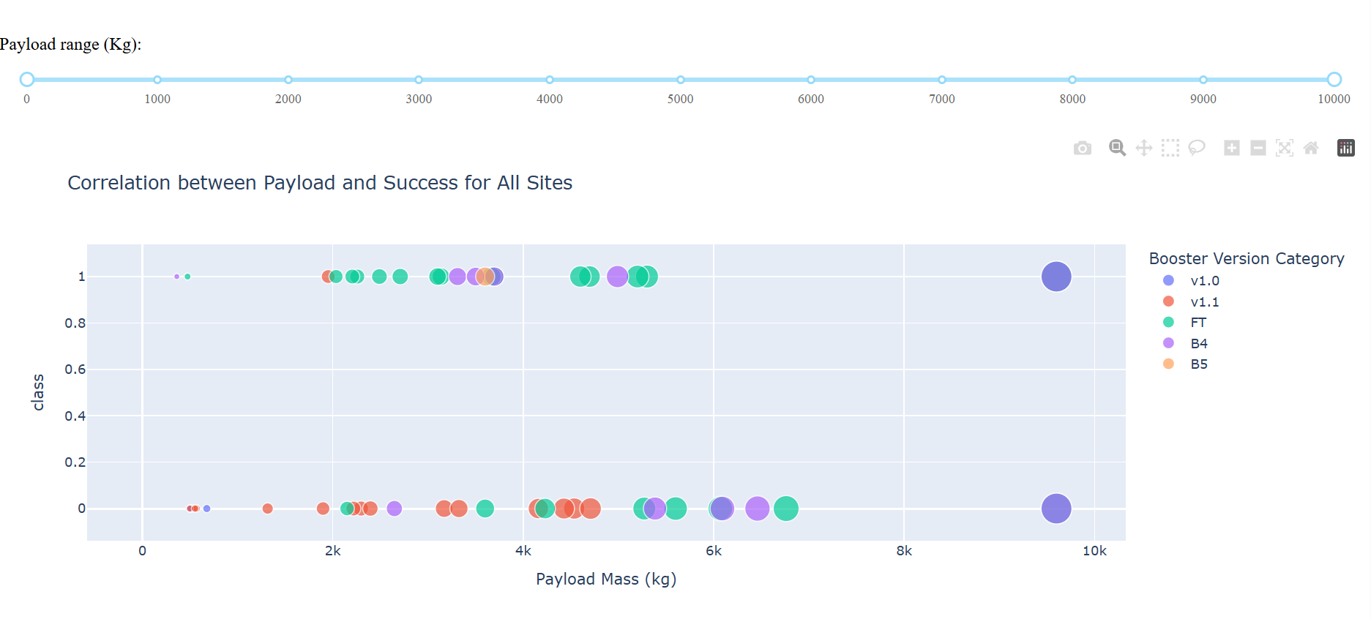
Correlation between Payload and success for All Sites
Key Findings from the Chart
🔹 Success Cluster
A strong cluster of successful launches (class = 1) is visible between 2000 – 6000 kg, particularly for FT (Full Thrust), B4, and B5 booster versions.
These boosters seem most reliable in this mid-payload range.
🔸 Low Success for v1.0
v1.0 boosters (purple) show lower success, especially around extreme payloads (~10,000 kg). Both success and failure are seen, but failures dominate outside the 6000–10000 kg range.
⚖️ Balanced Range for High Success
Most consistently successful missions fall between 2000 – 6000 kg, regardless of booster version, though FT and B5 tend to dominate in terms of reliability.
The most successful combination appears to be FT, B4, and B5 boosters with payloads in the range of 2,000–6,000 kg.
Heavier payloads (>8000 kg), especially on older boosters like v1.0, show a significantly lower success rate.

Slide 47

Section 5

Slide 48
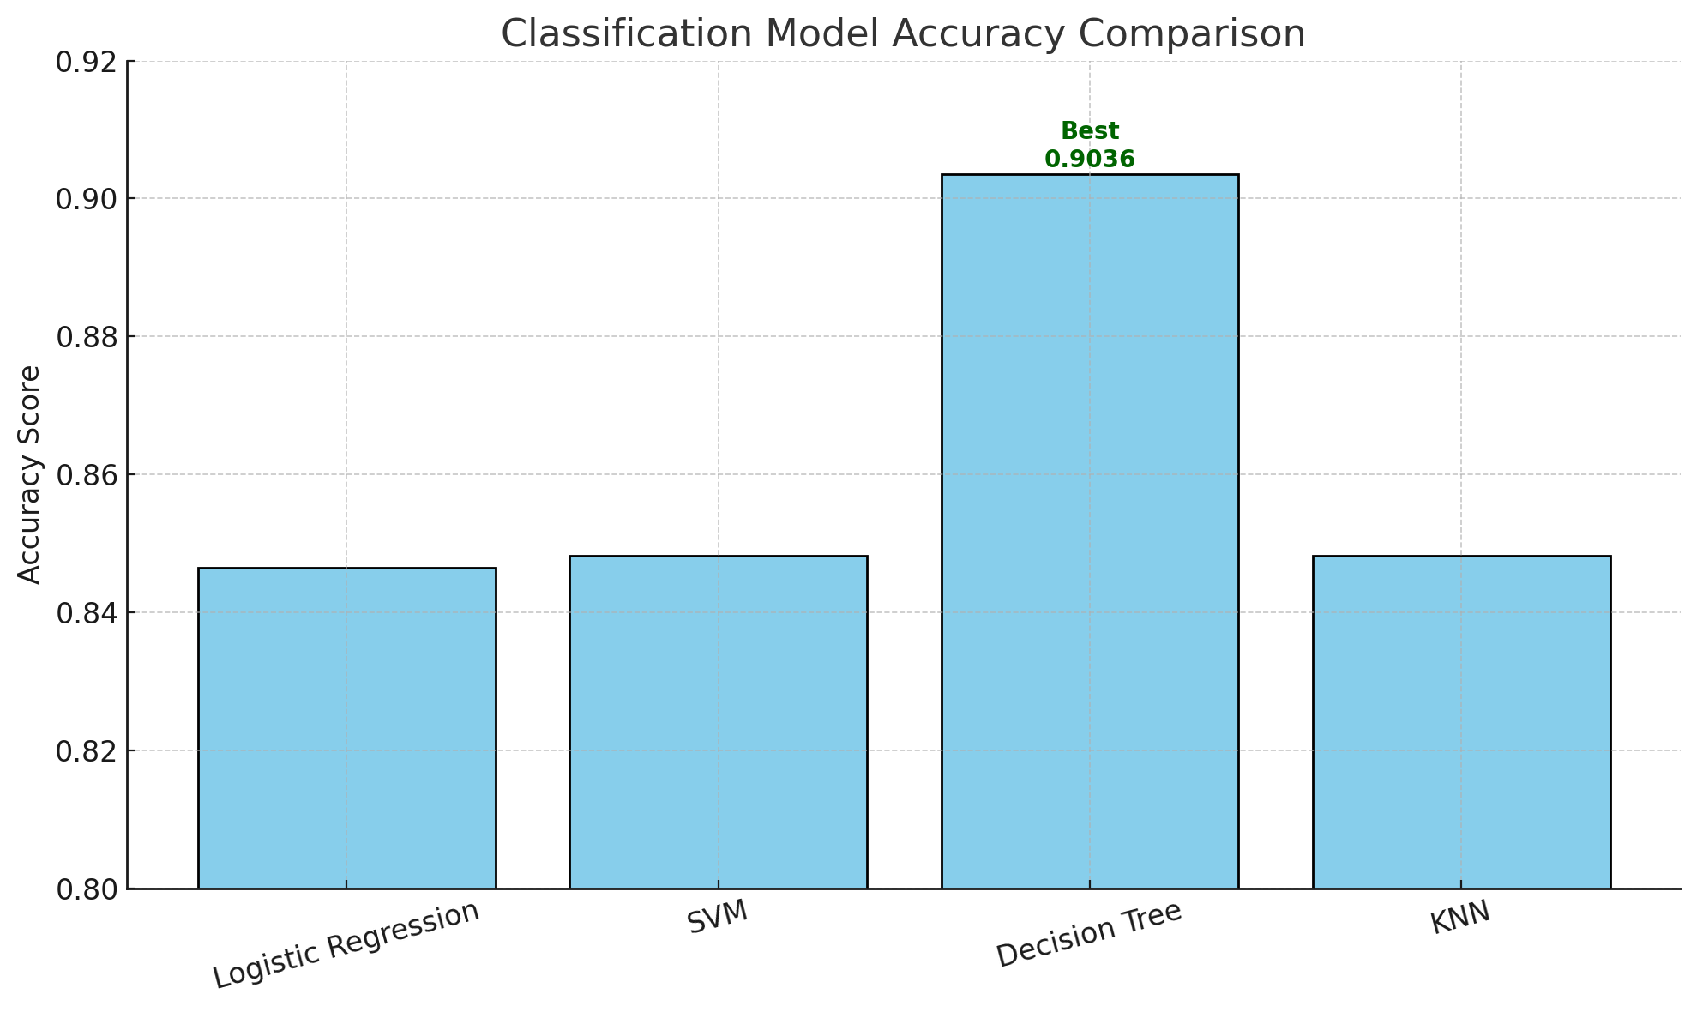
Classification Accuracy
Findings:
Decision Tree achieved the highest accuracy at 0.9036, making it the best performing model in this project.
Other models (Logistic Regression, SVM, KNN) performed well but slightly lower.

Slide 49

Confusion Matrix
This is a confusion matrix, a tool used to evaluate the performance of a classification model. It compares true labels (actual outcomes) with predicted labels produced by the model. Here’s how to interpret this specific matrix:
✅ What This Means:
True Positives (TP = 11): The model correctly predicted the rocket landed.
True Negatives (TN = 5): The model correctly predicted the rocket did not land.
False Positives (FP = 1): The model incorrectly predicted the rocket landed (but it didn't).
False Negatives (FN = 1): The model incorrectly predicted the rocket did not land (but it did).
This confusion matrix shows that the model is highly accurate and well-balanced, with only 2 misclassifications out of 18 total predictions. It performs very well at predicting both successful and failed landings—ideal for supporting mission planning decisions.

Slide 50
Conclusions
Point 1: We successfully built a complete data science pipeline—from data collection and wrangling to interactive visualization and machine learning—using real SpaceX launch data.
Point 2: Through Exploratory Data Analysis (EDA), we identified key factors such as launch site, payload mass, and orbit type that significantly influence mission success.
Point 3: Our interactive dashboard allowed dynamic exploration of mission outcomes, making complex insights accessible to both technical and non-technical stakeholders.
Point 4: Predictive models like Decision Trees and SVM achieved high accuracy (>85%), empowering SpaceX and other aerospace firms to make data-driven launch decisions and reduce mission risk.

Slide 51
Notebook Title | Content Highlights
jupyter-labs-spacex-data-collection-api.ipynb | API calls, data extraction & normalization
jupyter-labs-webscraping-checkpoint.ipynb | Raw table scraping and transformation
edadataviz.ipynb | EDA charts: bar, scatter, box, pie
SpaceX_Machine Learning Prediction_Part_5.ipynb | Classification models, tuning, evaluation
jupyter-labs-eda-sql-coursera_sqllite.ipynb | SQL data extraction and logic filtering
Appendix

Slide 52


